Slide 1

MY
FITNESS PAL
Fitness Management System

Slide 2


OUR TEAM
CHIENYU CHEN
YIHAN XU
ZILIANG ZHAO
ZHENYU WANG
JINGZHENG SONG
chen.chieny@northeastern.edu
xu.yihan@northeastern.edu
zhao.zili@northeastern.edu
wang.zhenyu1@northeastern.edu
song.jingz@northeastern.edu

Slide 3
OUTLINE
PRODUCT
01
TECHNIQUE
02
METHODOLOGY
03
Q&A
04
INTRO / FEATURES / DEMO
FRONT / BACK / DB
COMM / DOCS / TOOLS
Feel free to ask us anything!

Slide 4
01
PRODUCT
Take control of your life from this moment.

Slide 5

INTRODUCTION
A fitness management system that could provide foods and sports information for members.
My Fitness Pal builds on Vue.js front-end framework. Servers are based on Java SpringBoot and MySQL.

Slide 6
PRODUCT FEATURES
THE APP DESIGN
User Management
Sports Information
Calories Consumption Table
Recipe Search
To be continued...

Slide 7

DEMO

Slide 8
02
TECHNIQUE
Full-stack Web Development

Slide 9



STACK
VUE
SPRING BOOT
MYSQL
The lightweight progressive front-end JavaScript framework.
Spring Boot offers a faster way to build Spring applications.
Fast, versatile and popular RDBMS.

Slide 10

What is VUE.js?
Vue.js is an open-source lightweight model–view–viewmodel front-end JavaScript framework for building user interfaces and single-page applications.

Slide 11
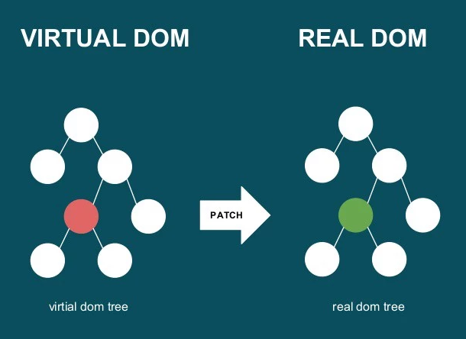
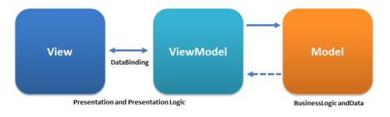
Benefit of using VUE.js
It’s lightweight (20 kb), very easy to install, perfect for small-scale projects.
Code less and achieve more.
Uses MVVM (model–view–viewmodel) which allows two-way communication.
Reusable components.
Virtual DOM, more efficient.

Slide 12
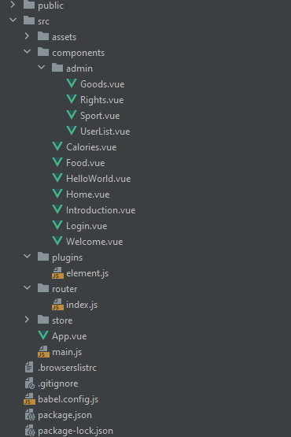
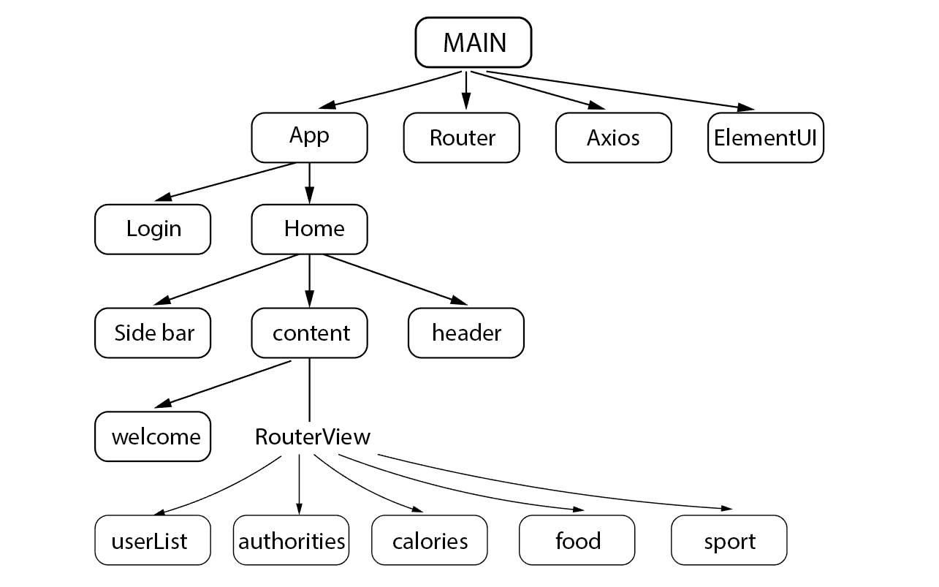
Project Front-end Structure

Slide 13
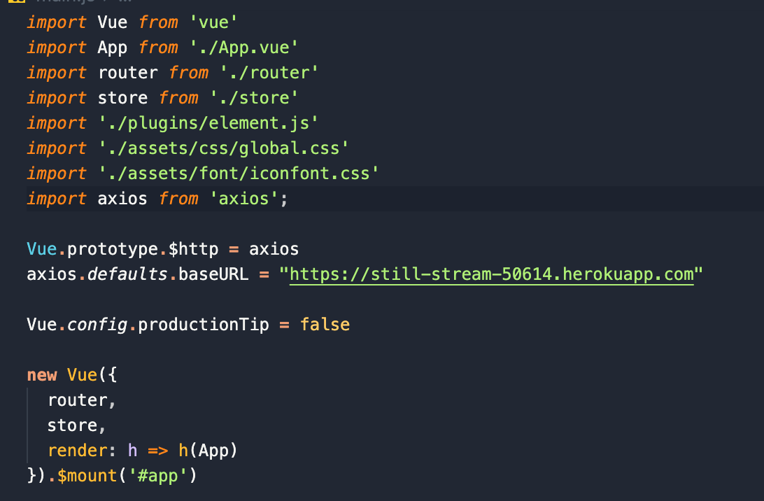
Project Details -- Main.js
Based on Vue CLI skeleton, import Element UI, Vue Router and axios in the app.
Define global styles in assets folder and use them.
Set default request baseURL globally.

Slide 14
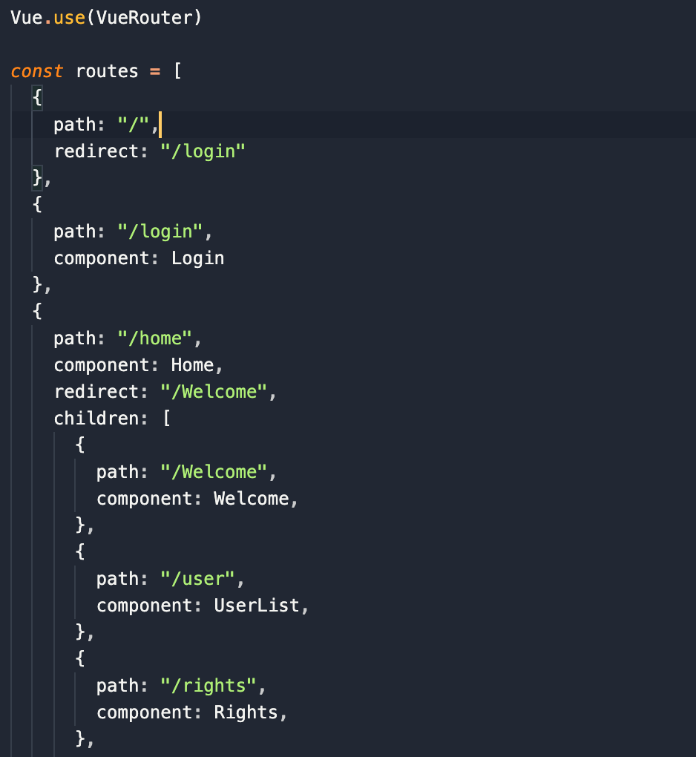
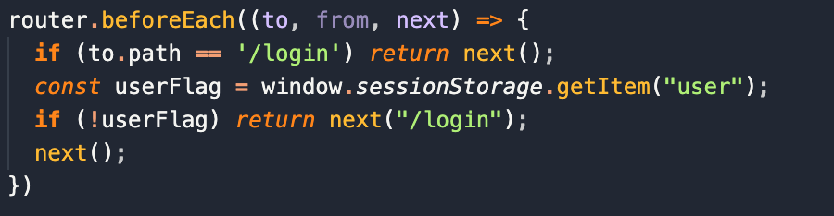
Project Details -- router
Register all routes in VueRouter.
Authentication middleware.

Slide 15
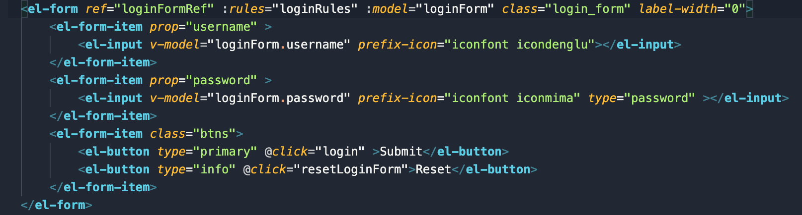
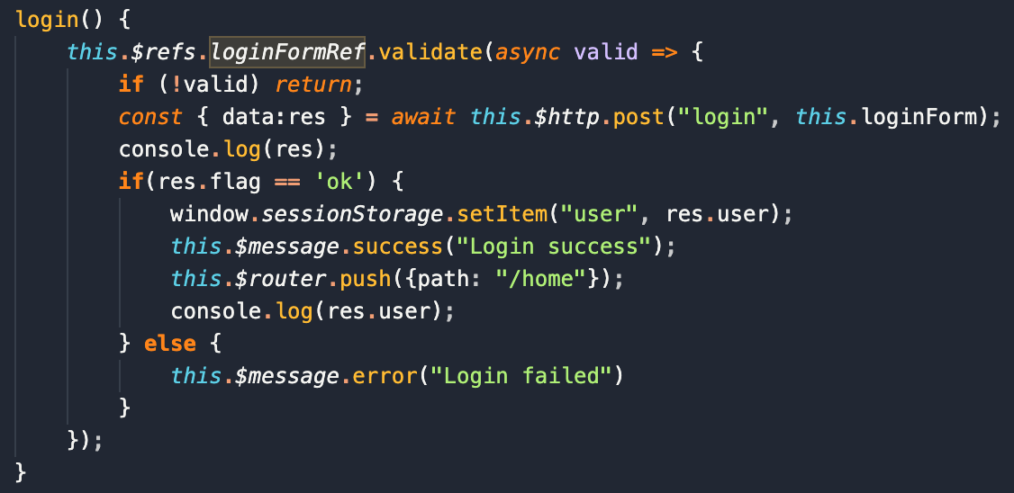
Project Details -- Login.vue
Get the form via ref so that we can use its methods such as resetFields and validate.
V-model bind the form and its input field.
Add input validation schema.
Handle onclick event.
Send login request to backend.

Slide 16
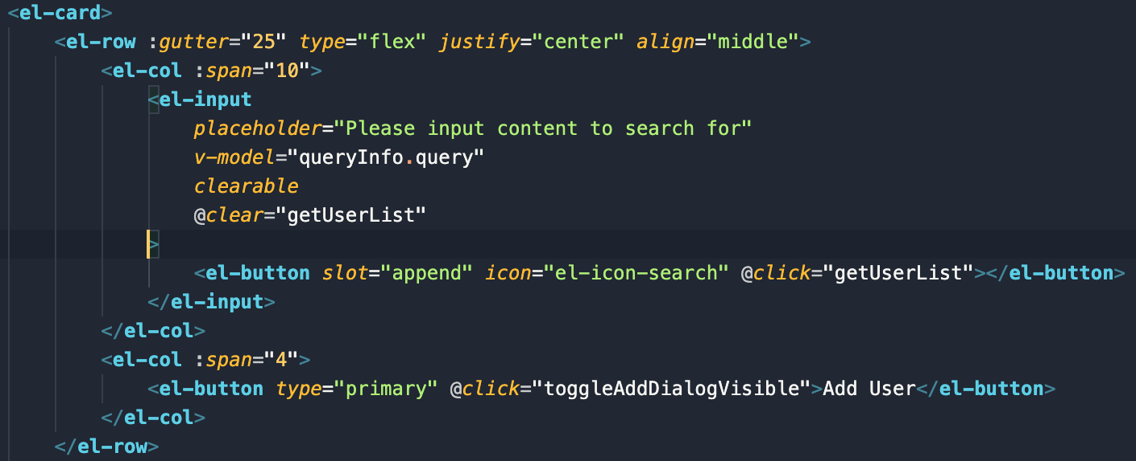
Project Details -- UserList
Filter and display members in the system:
Combine el-row, el-column and el-input component into a reusable search box component.
Under the search box component, display a table with el-table and el-table column.
Handle events, add dialog and modals.
Implement and add reusable pagination component at the bottom.

Slide 17
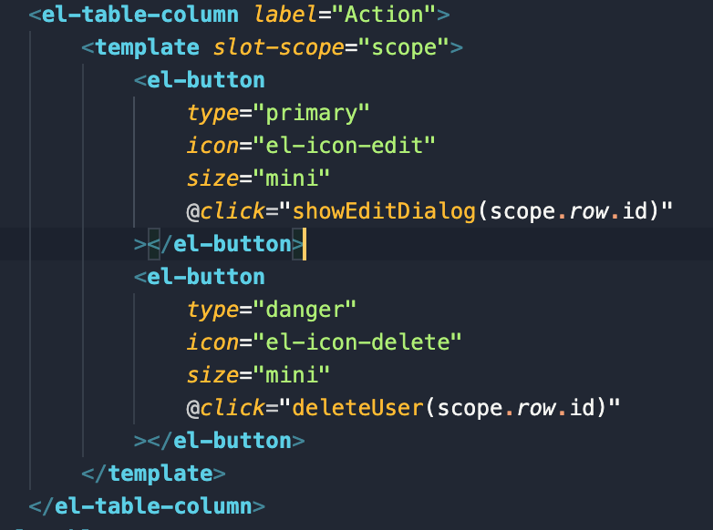
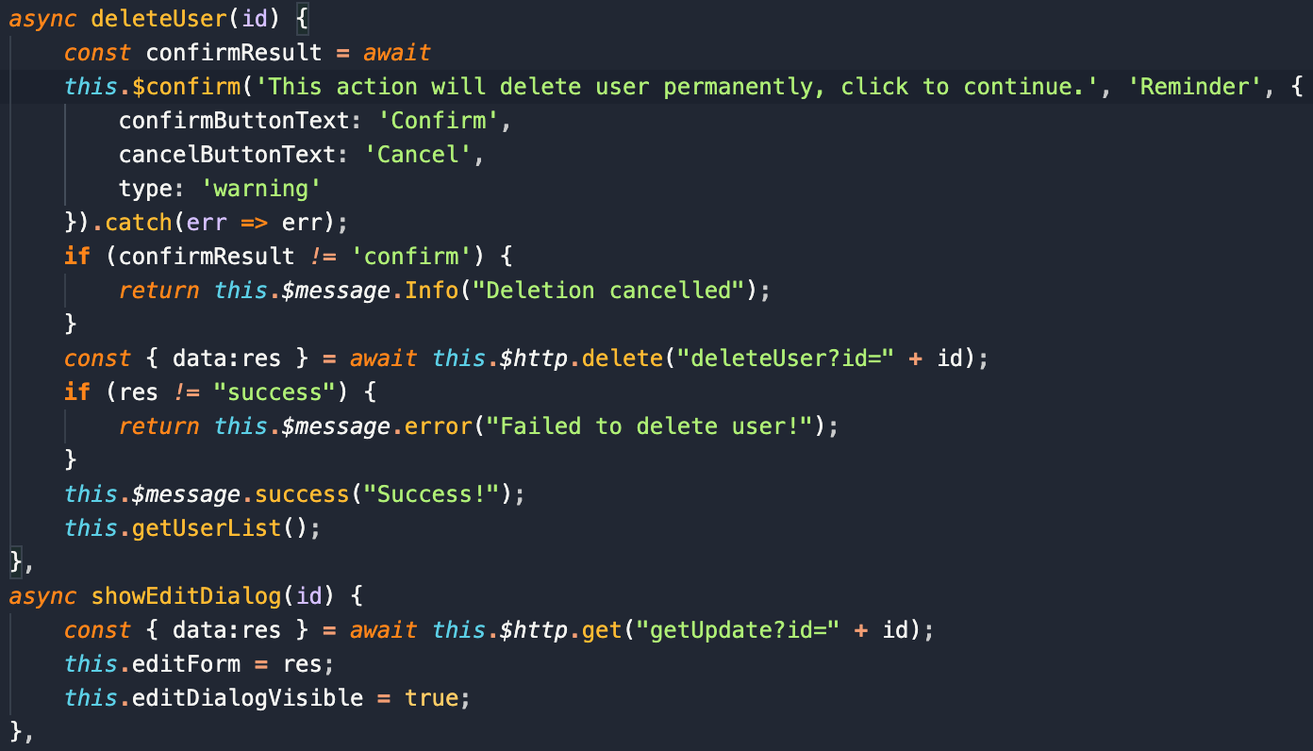
Project Details -- UserList
Under the search box component, display a table
with el-table and el-table column.

Slide 18
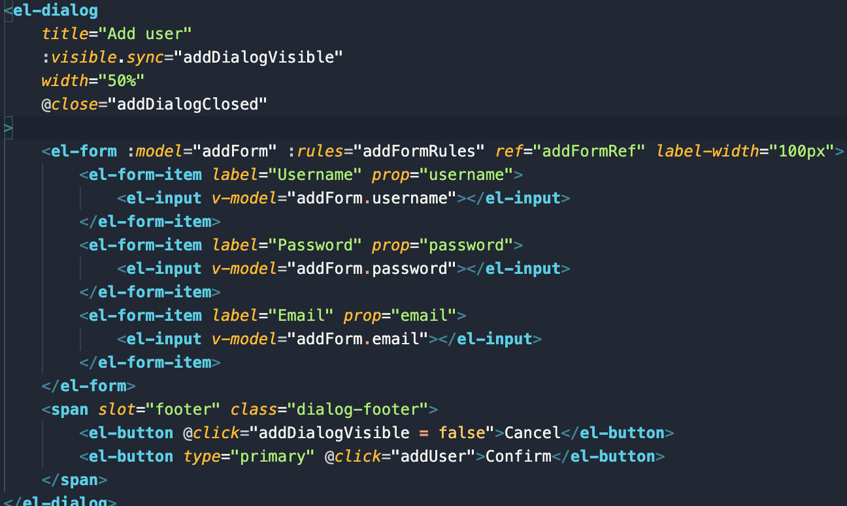
Project Details -- UserList
Handle events, add dialog and modals.

Slide 19
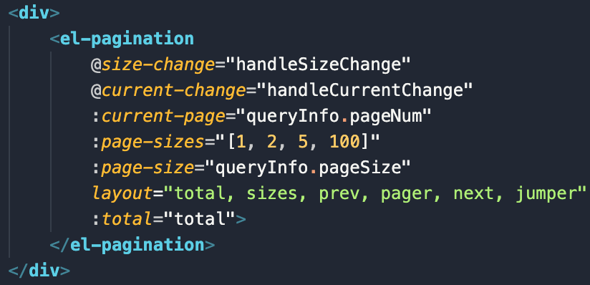
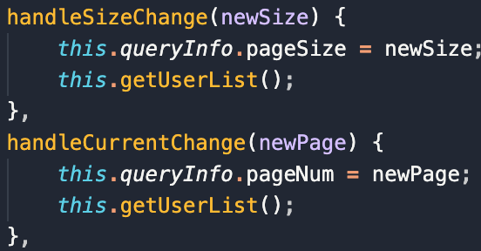
Project Details -- UserList
Under the search box component, display a table
with el-table and el-table column.

Slide 20
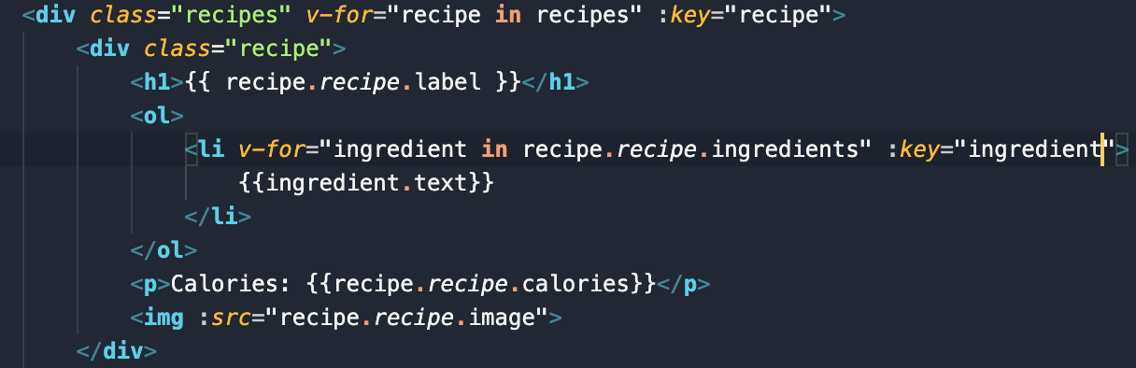
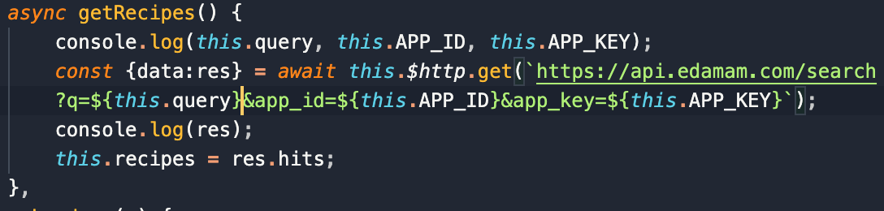
Project Details -- Food.vue
Fetch recipes and their ingredients from
Edamam API.
Store result in state and render list with v-for.

Slide 21
Challenges
New technical stack, learning curve not smooth
Solution:
Watch tutorials.
Don’t be afraid to try.
Time difference
Solution:
Stick to communication plan and development methodology.
Communicate and debug in time.
Conflicts between front-end and back-end, and how to debug
Solution:
Use postman.
Check API docs.
Use console.log().
Communicate with teammates.

Slide 22
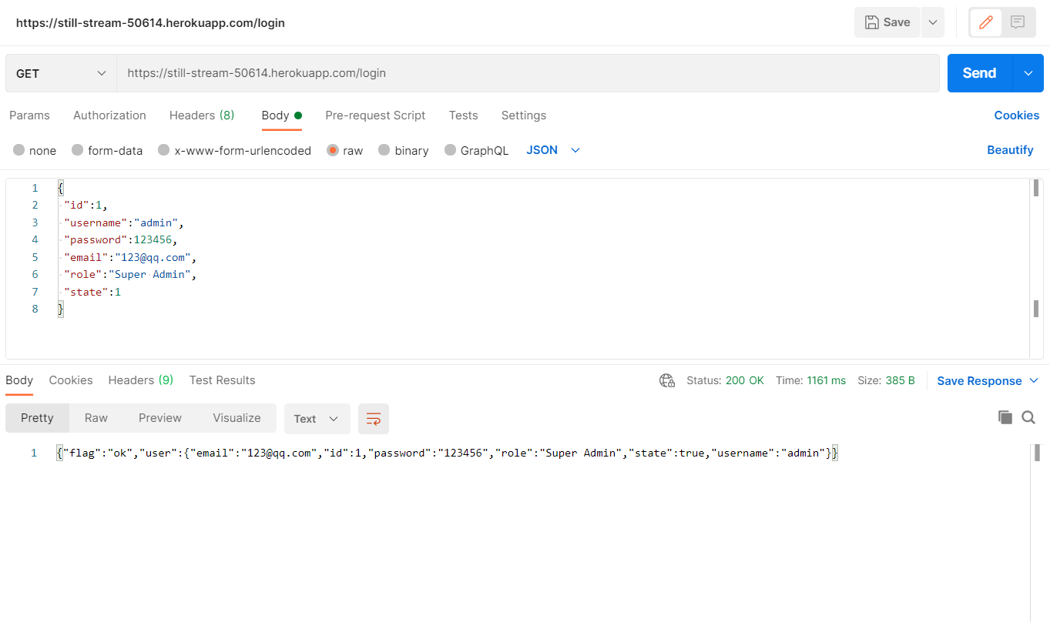
Challenges
Use postman to test backend API.

Slide 23
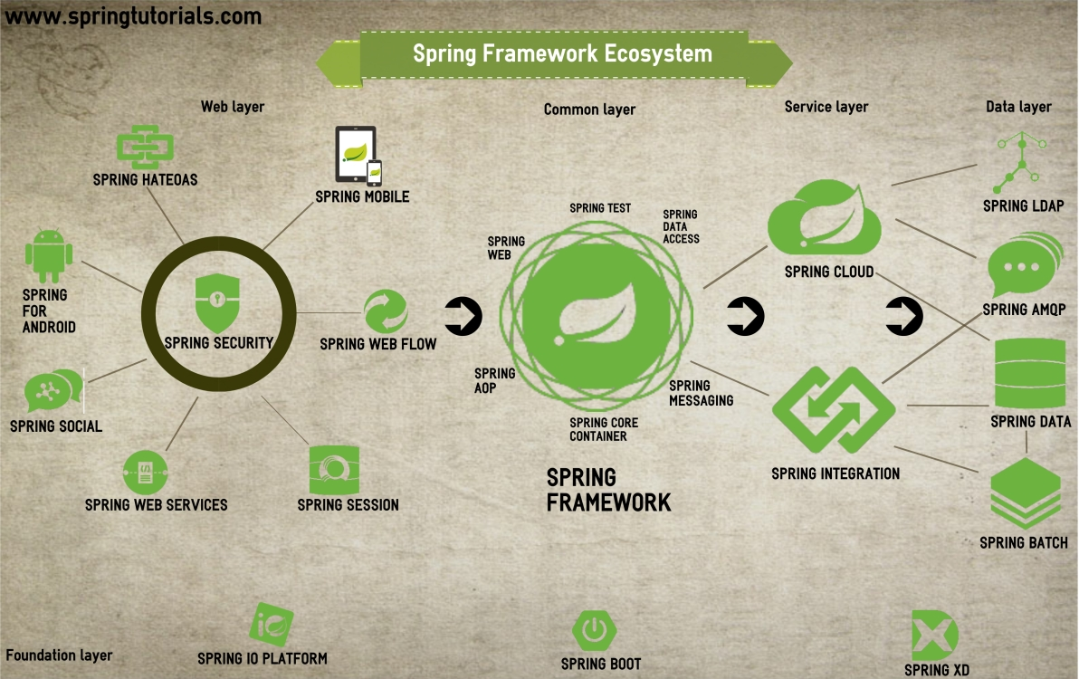
Spring EcoSystem
Inversion of Control
Dependency Injection
Spring Boot?

Slide 24
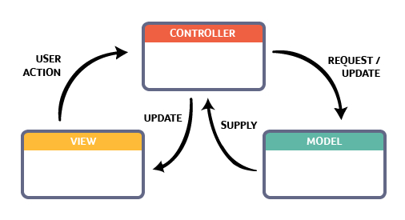
Spring and MVC
Features
Flexible, loosely coupled
Model encapsulate data
View using Model to render
Controller processes requests

Slide 25
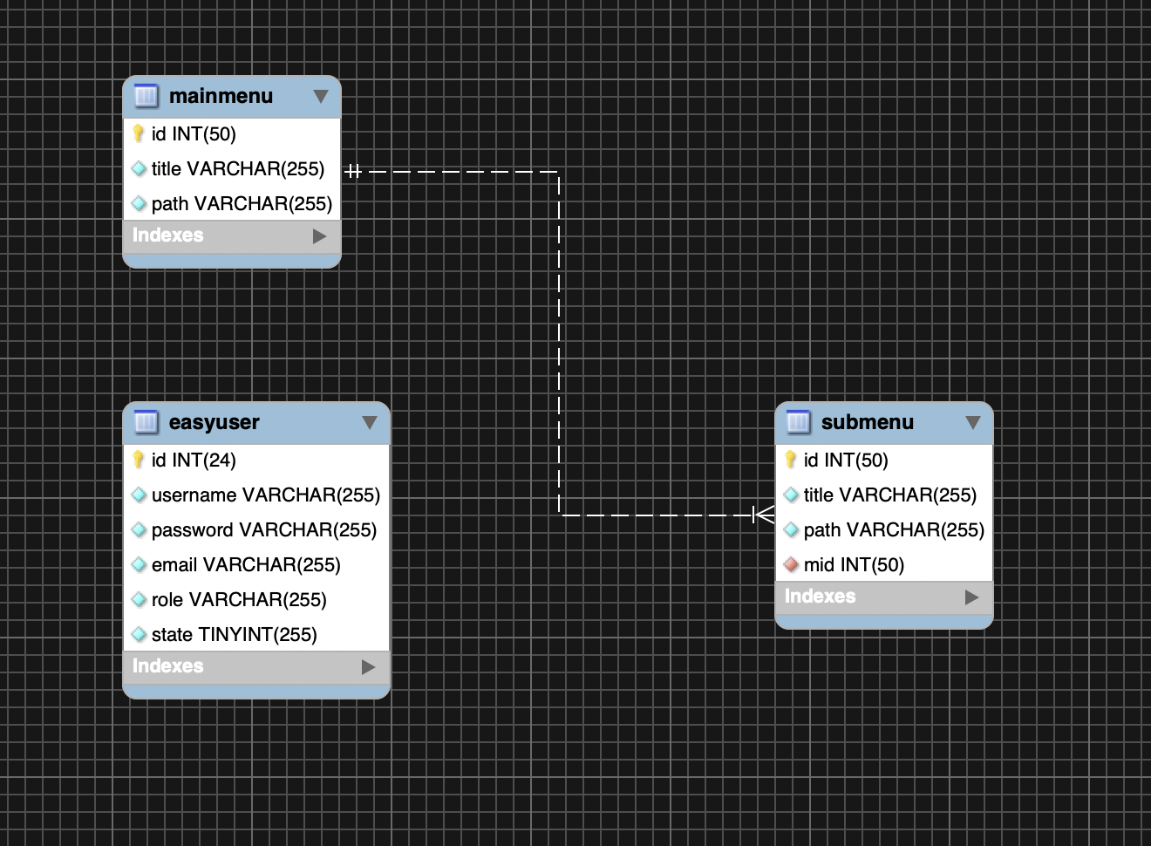
MySQL RDBMS
Features
Open-source, popular
Web development
One of Largest Community
ClearDB Add-on

Slide 26
03
METHODOLOGY
Software Process Methodology
Communication Plan
Documents & Tools
Feedback

Slide 27
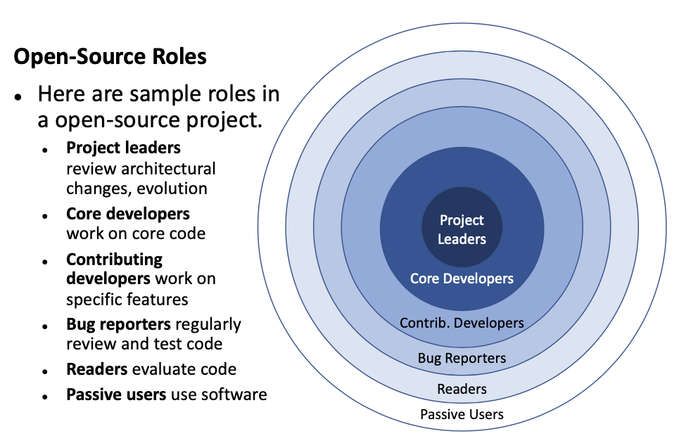
Software Process Methodology
Open-Source Model

Slide 28
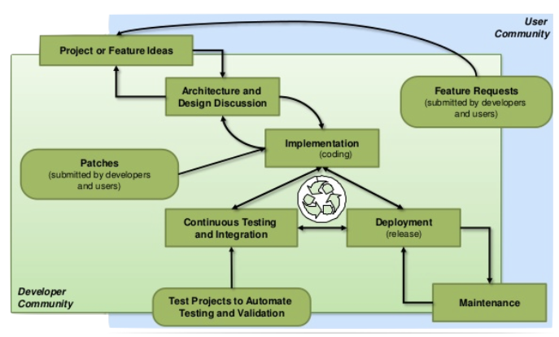
Software Process Methodology
Open-Source Model
Project or feature ideas.
Architecture and design discussion.
Collaboration on implementation.
Source code submission and evaluation.
Continuous testing and integration.
Source code release and deployment.

Slide 29
Communication Plan
Communication | Method | Frequency | Goal | Owner | Audience | Others
Team Standup | WeChat | Daily | Discuss what each team member did yesterday, what they'll do today, and any blockers | Project Team | Project team
Task Progress Updates | Github | Daily | Share daily progress made on project tasks | Project Team | Project team | Ephemeral: Wechat Preserved: Google Doc
Project Progressing Discussion | Zoom + Google Doc | Weekly | Review project status and discuss potential issues or delays. Use google doc to record the discussion. | Project Team | Project team
Project Status Report | Email | Weekly | Provide the project status to the stakeholders. Ask if there are additional requirements or modifications. | Project Team | Project team + Stakeholders | Compare against milestone
Project Milestone Review | Piazza / Short Email Notice | At milestones | Gather feedback, accumulate potential customers and discuss next steps. | Project Team | Customers | Demo with Tiktok clips / Keep them inform / Decision --> business strategy(coming soon.. newstuff...)
Post-mortem meeting | Meeting | At end of project | Assess what worked and what did not work and discuss actionable takeaways | Project Team | Project team

Slide 30
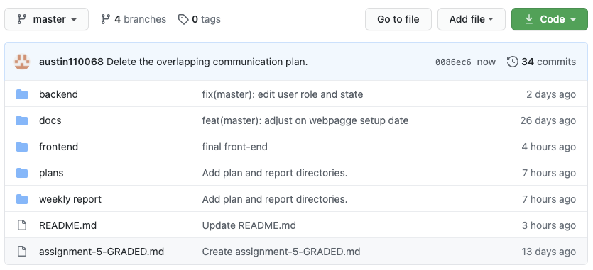
Documents & TOOLS
Github - Repository
Coding
Frontend
Backend
Docs
Plans
Weekly report
README.md

Slide 31
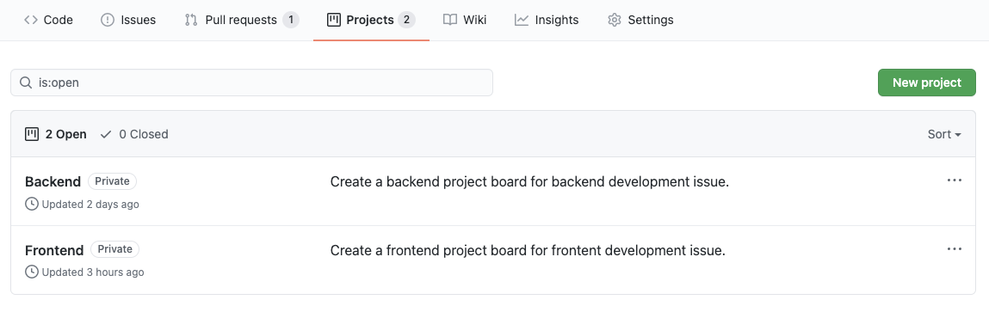
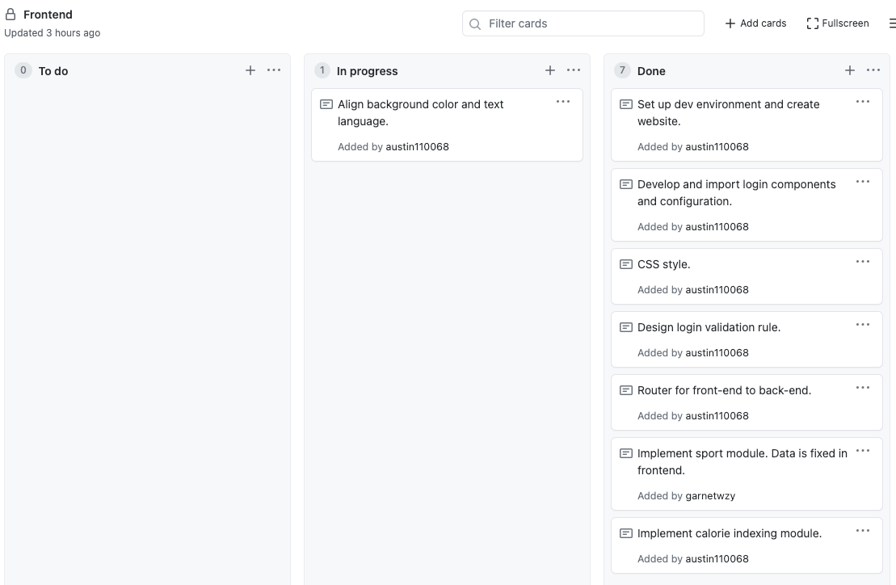
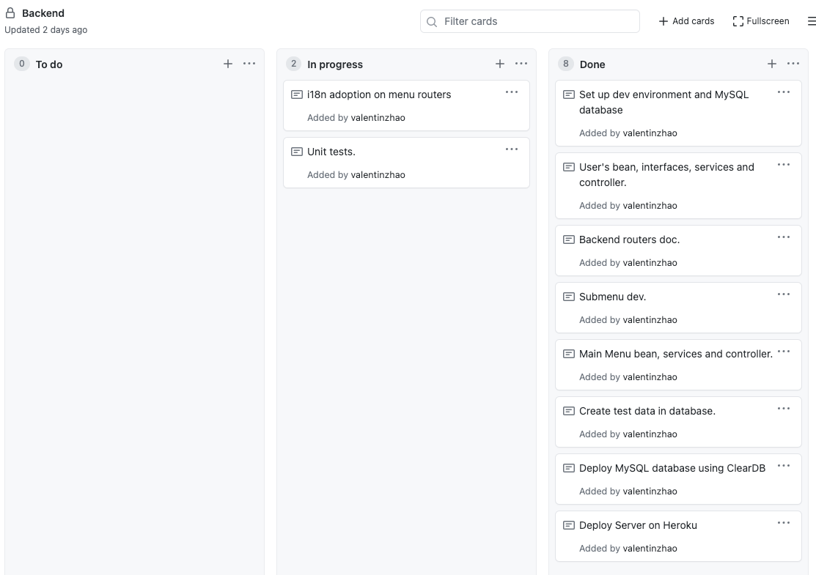
Documents & TOOLS
Github - Backlog

Slide 32
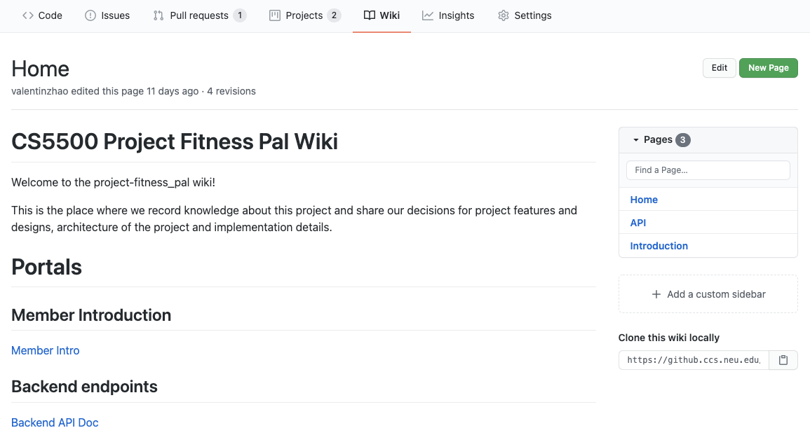
Documents & TOOLS
Github - Wiki

Slide 33
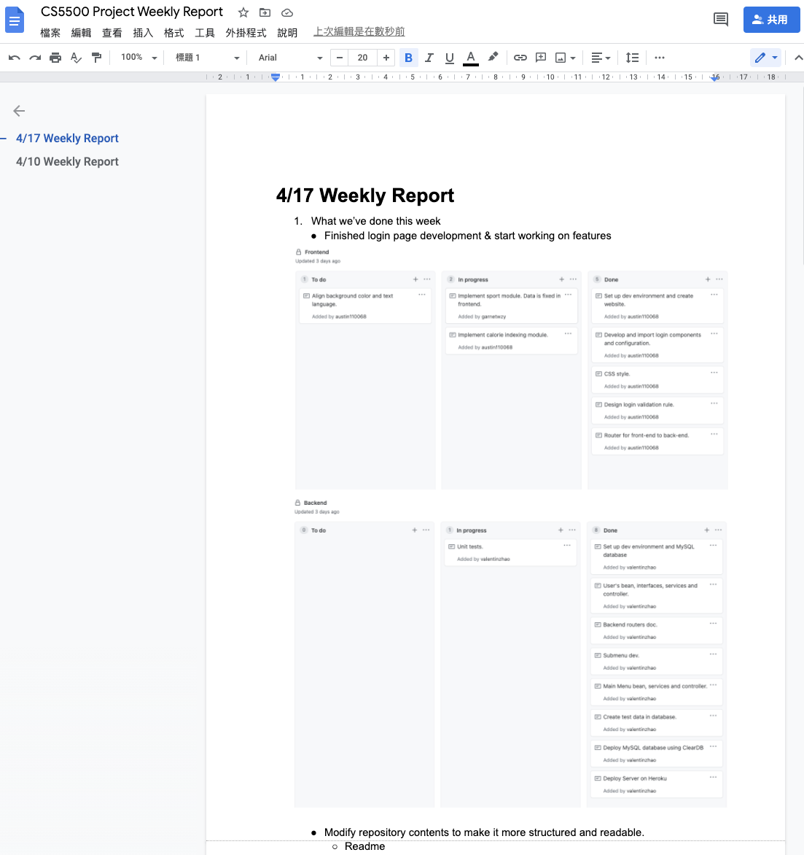
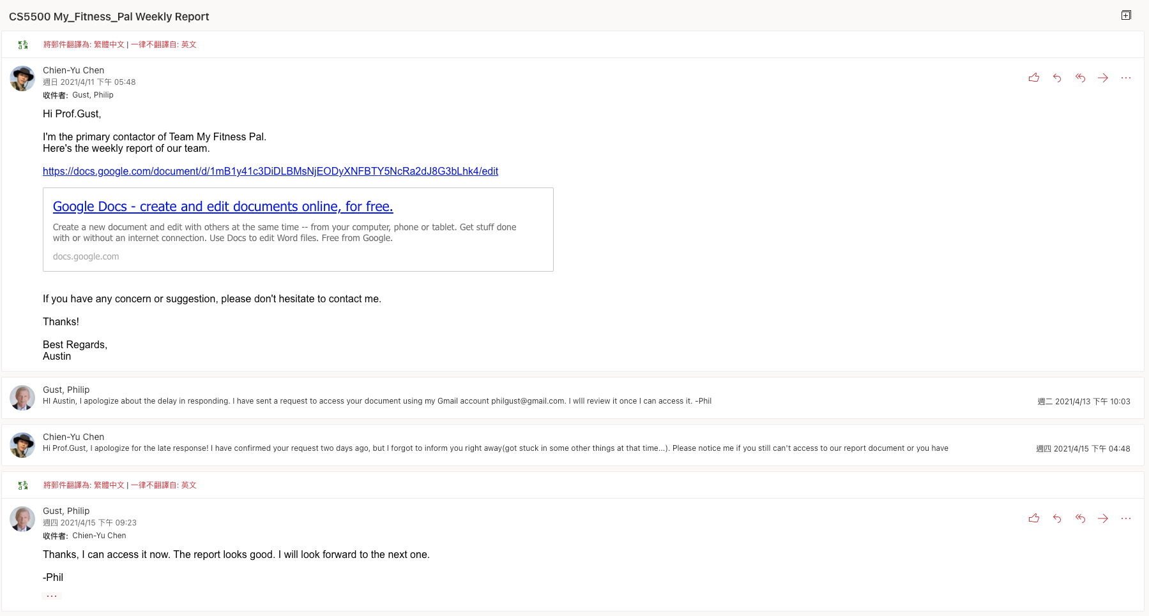
Documents & TOOLS
Weekly Report

Slide 34
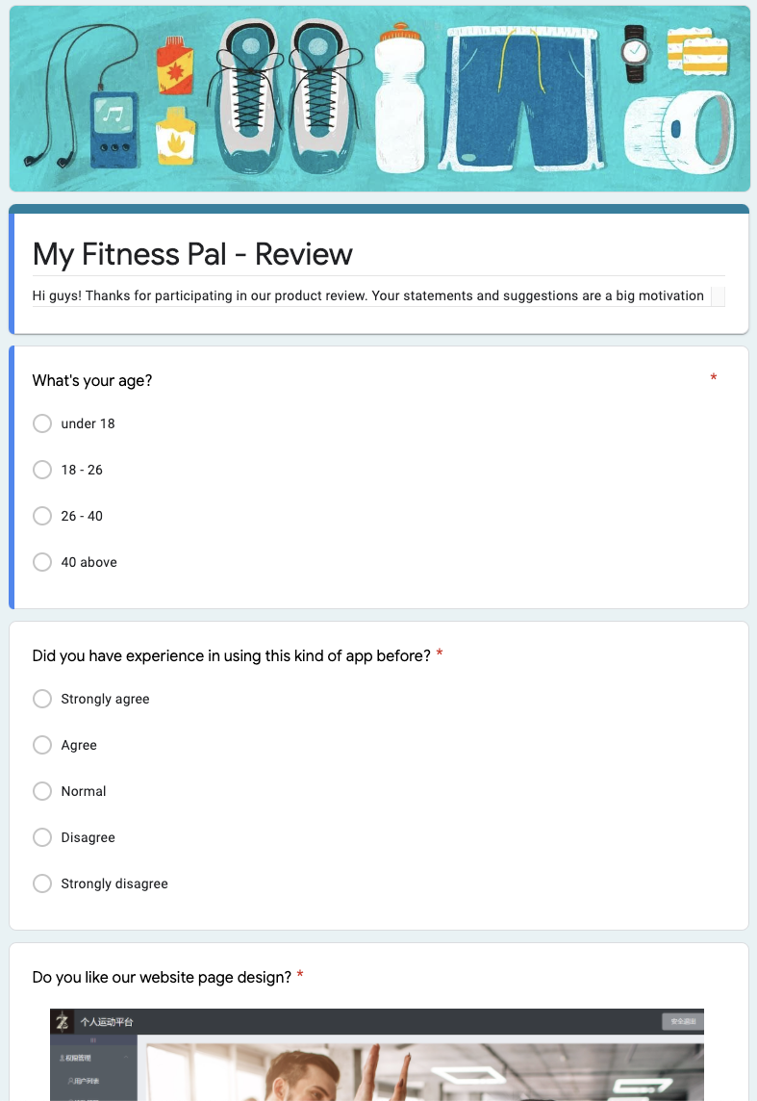
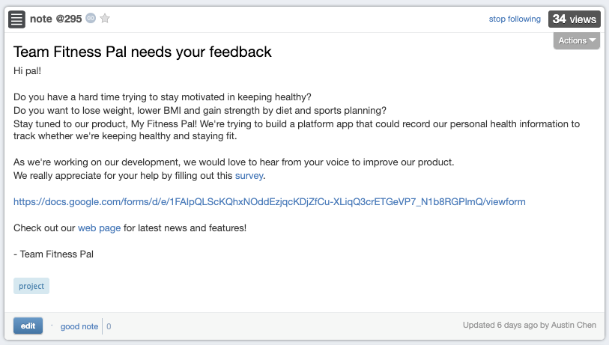
Feedback
Announcement

Slide 35
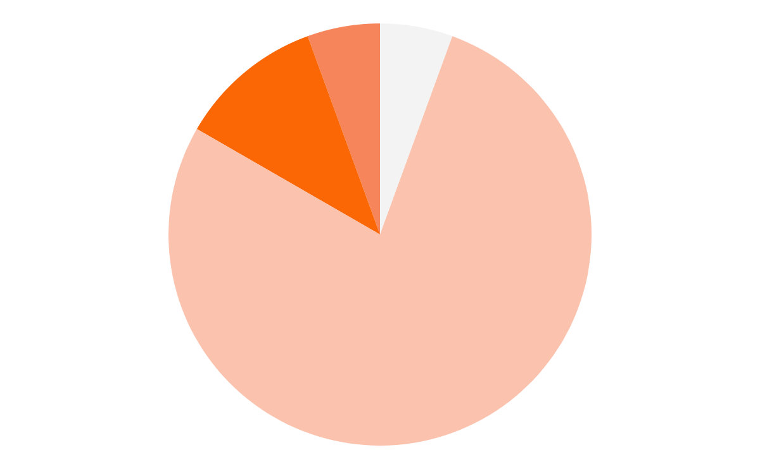
FEEDBACK
5.6 %
AGE : UNDER 18
5.6 %
AGE : ABOVE 40
11.1 %
AGE : 26 - 40
77.7 %
AGE : 18 - 26
What’s your age?

Slide 36
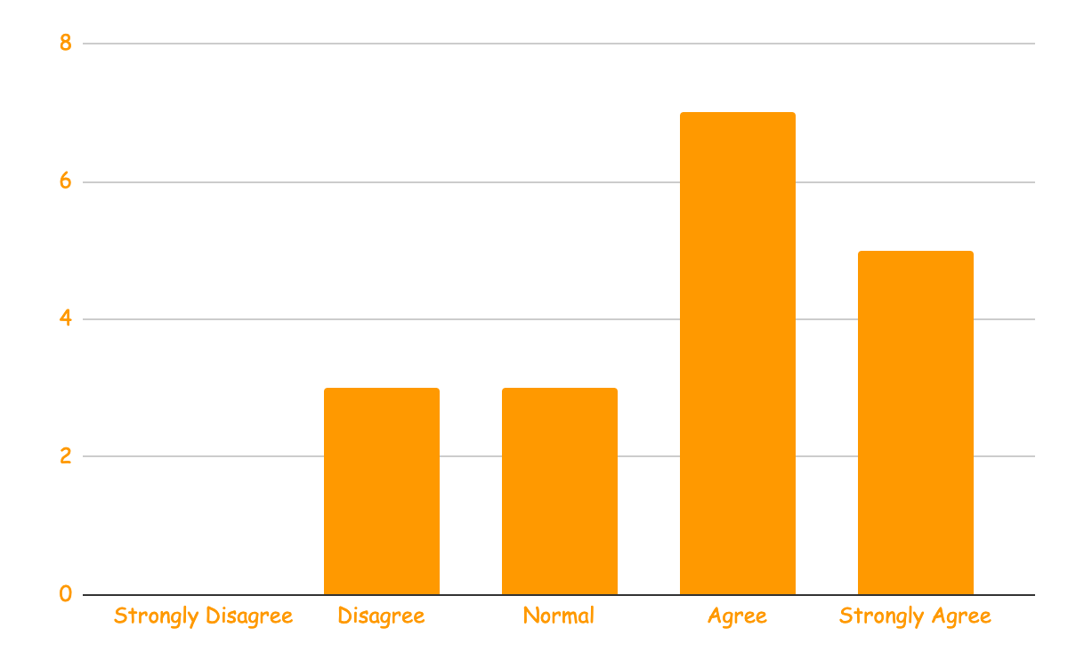
FEEDBACK
Did you have experience in using this kind of app before?

Slide 37
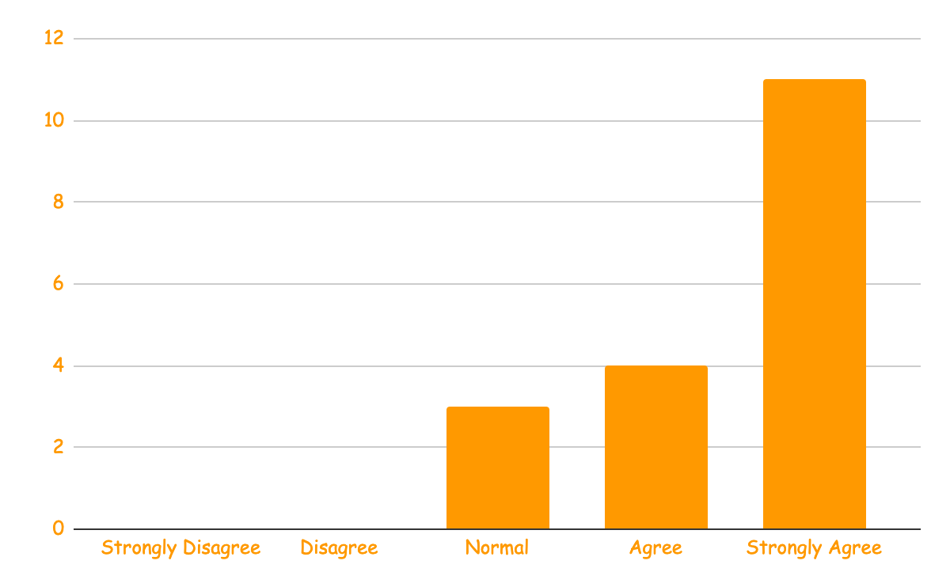
FEEDBACK
Do you like our website page design?

Slide 38
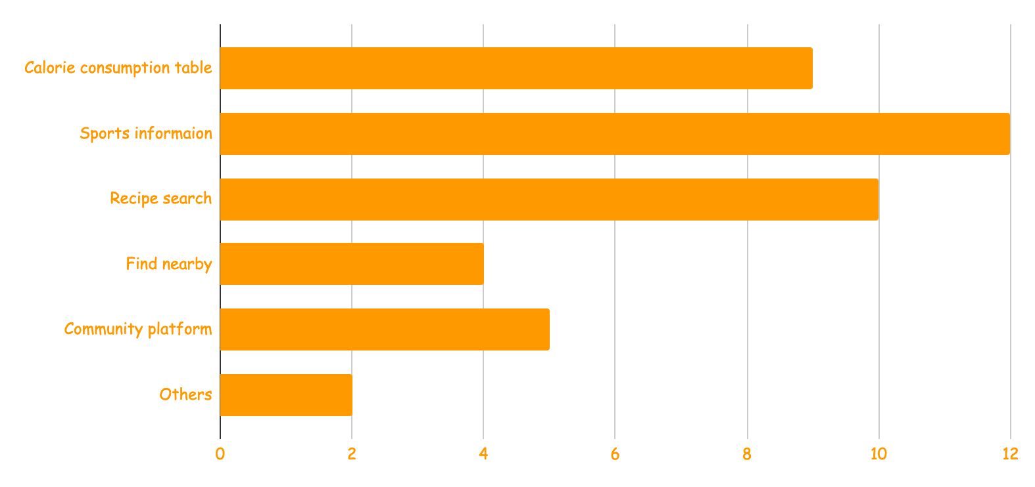
FEEDBACK
Which features do you like or need in our product?

Slide 39
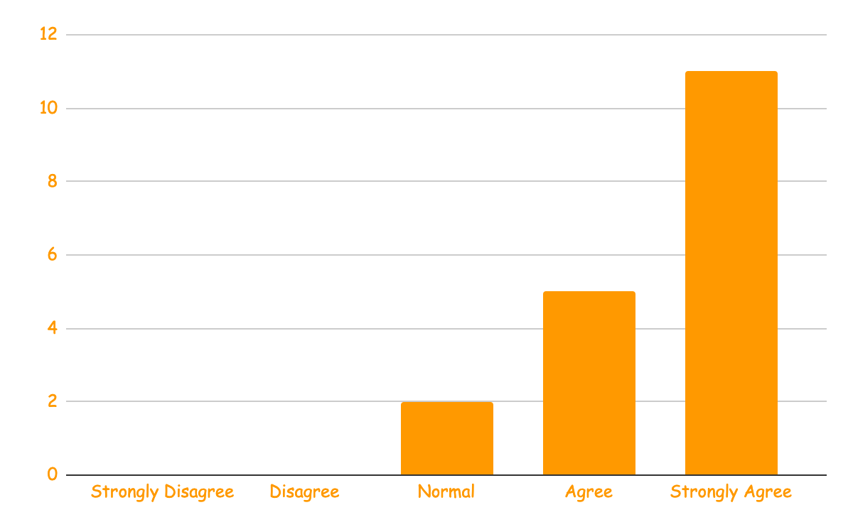
FEEDBACK
Will you recommend others to use our product?

Slide 40
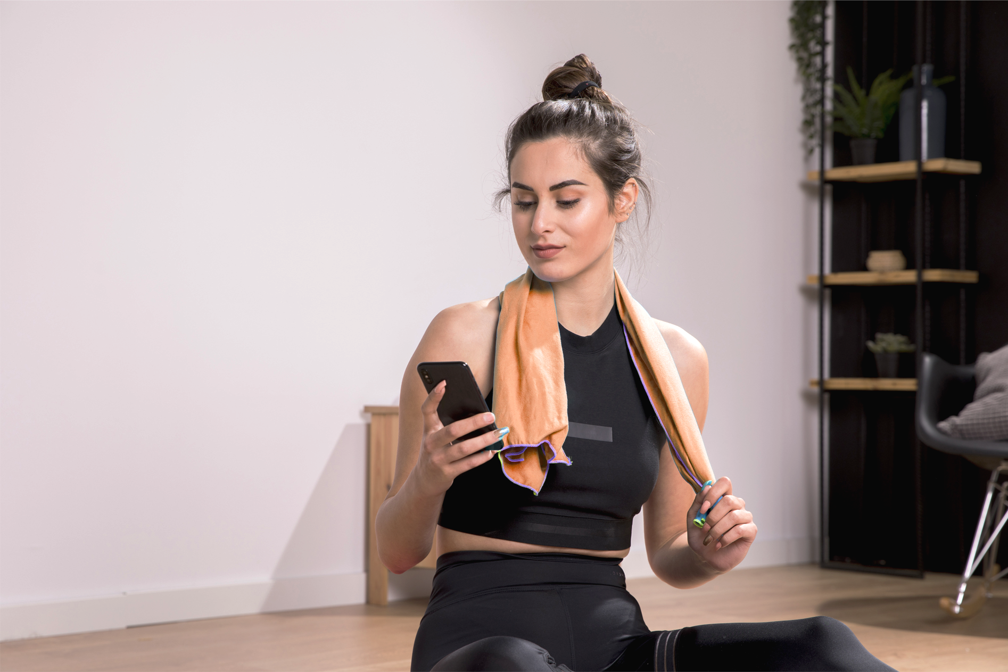
RECAP

Slide 41
04
Q & A

Slide 42


THANKS!
https://github.ccs.neu.edu/2021SPCS5500SB/project-fitness_pal
https://my-finess-pal.herokuapp.com/#/login
PLEASE KEEP THIS SLIDE FOR ATTRIBUTION.

